Slide 1
Phishing Awareness Training
Author: Dharani Kumar
.
i

Slide 2

CONTENTS
3C.ommon Types of Phishing Attacks
4H.ow to Spot a Phishing Email
1. Introduction to Phishing Awareness
2. What is Phishing?
25.real Example — Fake vs. Real
6. How to Protect Yourself
7H. ow to Report Suspicious Emails
8P.hishing Simulations
9Q.uick Quiz or Scenario
1S0u.mmary & Key Takeaways
1A1d. ditional Resources & Contacts
12. Thank You & Q&A

Slide 3




1. Introduction to Phishing Awareness
Title Slide
1 Slide Title 2
“Phishing Awareness Training”
Content
Your company/organization name & logo
Trainer name and date
Brief purpose of the session
3 Talking Points
Wh• y phishing is a major security threat
What the training will cover
4
Visuals
Company logo
A simple lock or phishing hook icon

Slide 4
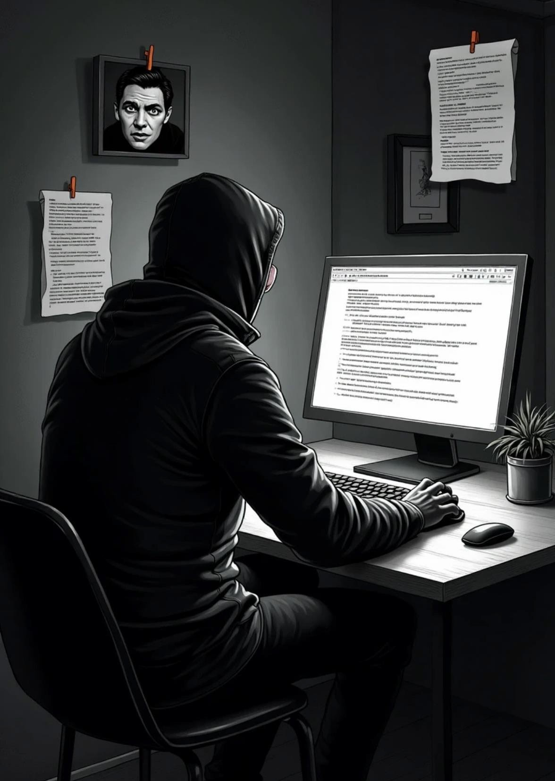



2. What is Phishing? Definition
Slide Title
“What is Phishing?”
Content
Definition of phishing
How attackers trick people into revealing information or downloading malware
Talking Points
Phishing is a form of social engineering
Commonly uses emails, SMS, fake websites, or calls
Visuals
Diagram showing attacker →
fake email → victim
Icon of envelope with a hook

Slide 5
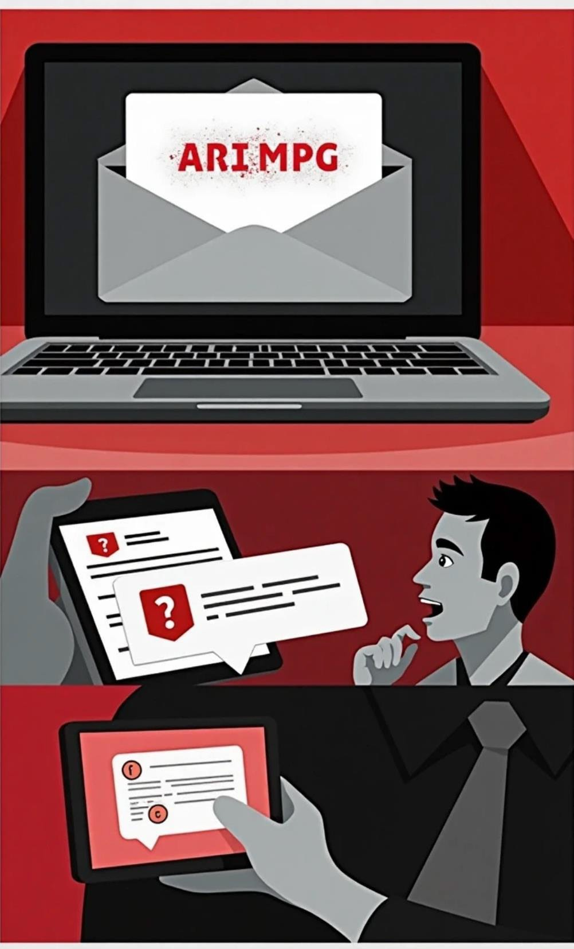






3. Common Types of Phishing Attacks
Types of Phishing
1
Slide Title
“Types of Phishing”
2
Content
Email Phishing:Fakeemails with malicious links or attachments
Spear Phishing:Targeted at individuals or departments
Whaling:Targets executives or high-value personnel
Smishing & Vishing:Via SMS or phone calls
3
Visuals
Icons for each type
Realisticexample(blurred sensitiveinfo)

Slide 6
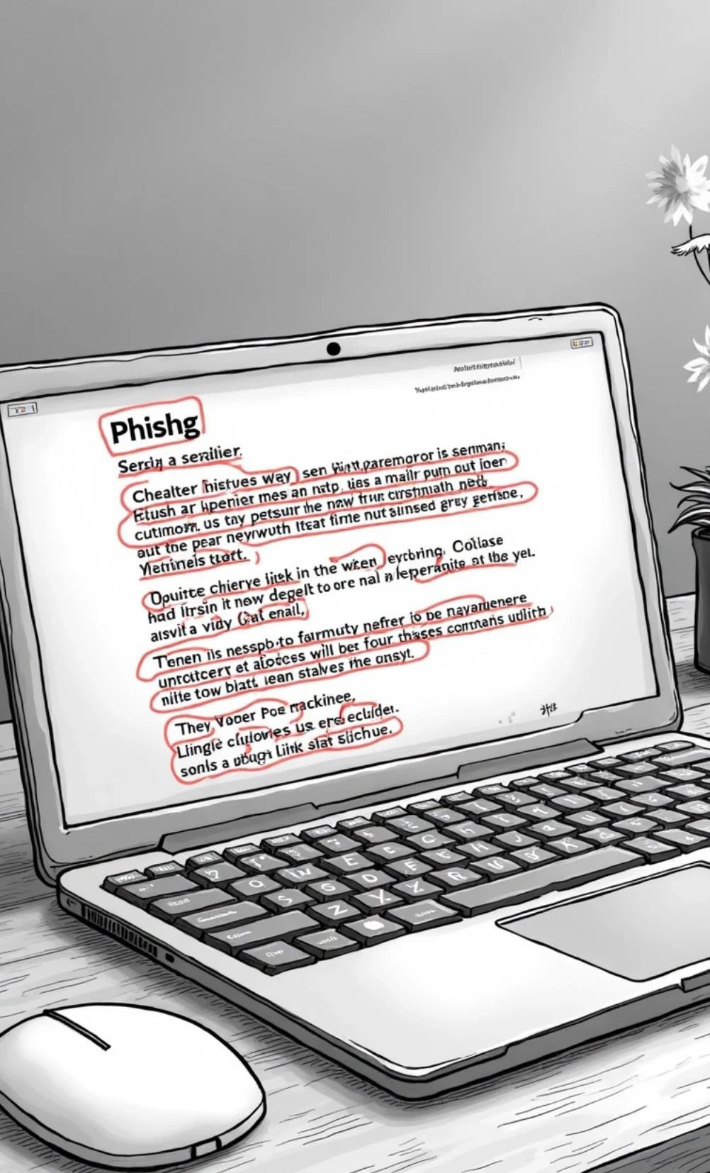


4. How to Spot a Phishing Email Red Flags
Slide Title
“Red Flags in Phishing Emails”
Content
Suspicious sender address
Generic greetings (“Dear user”)
Urgent or threatening tone
Grammar or spelling mistakes
Unexpected attachments or links
Talking Points
Encourage users to pause and think
before clicking
Visuals
Screenshot of a fake email with red
circles/highlights on red ﬂags

Slide 7
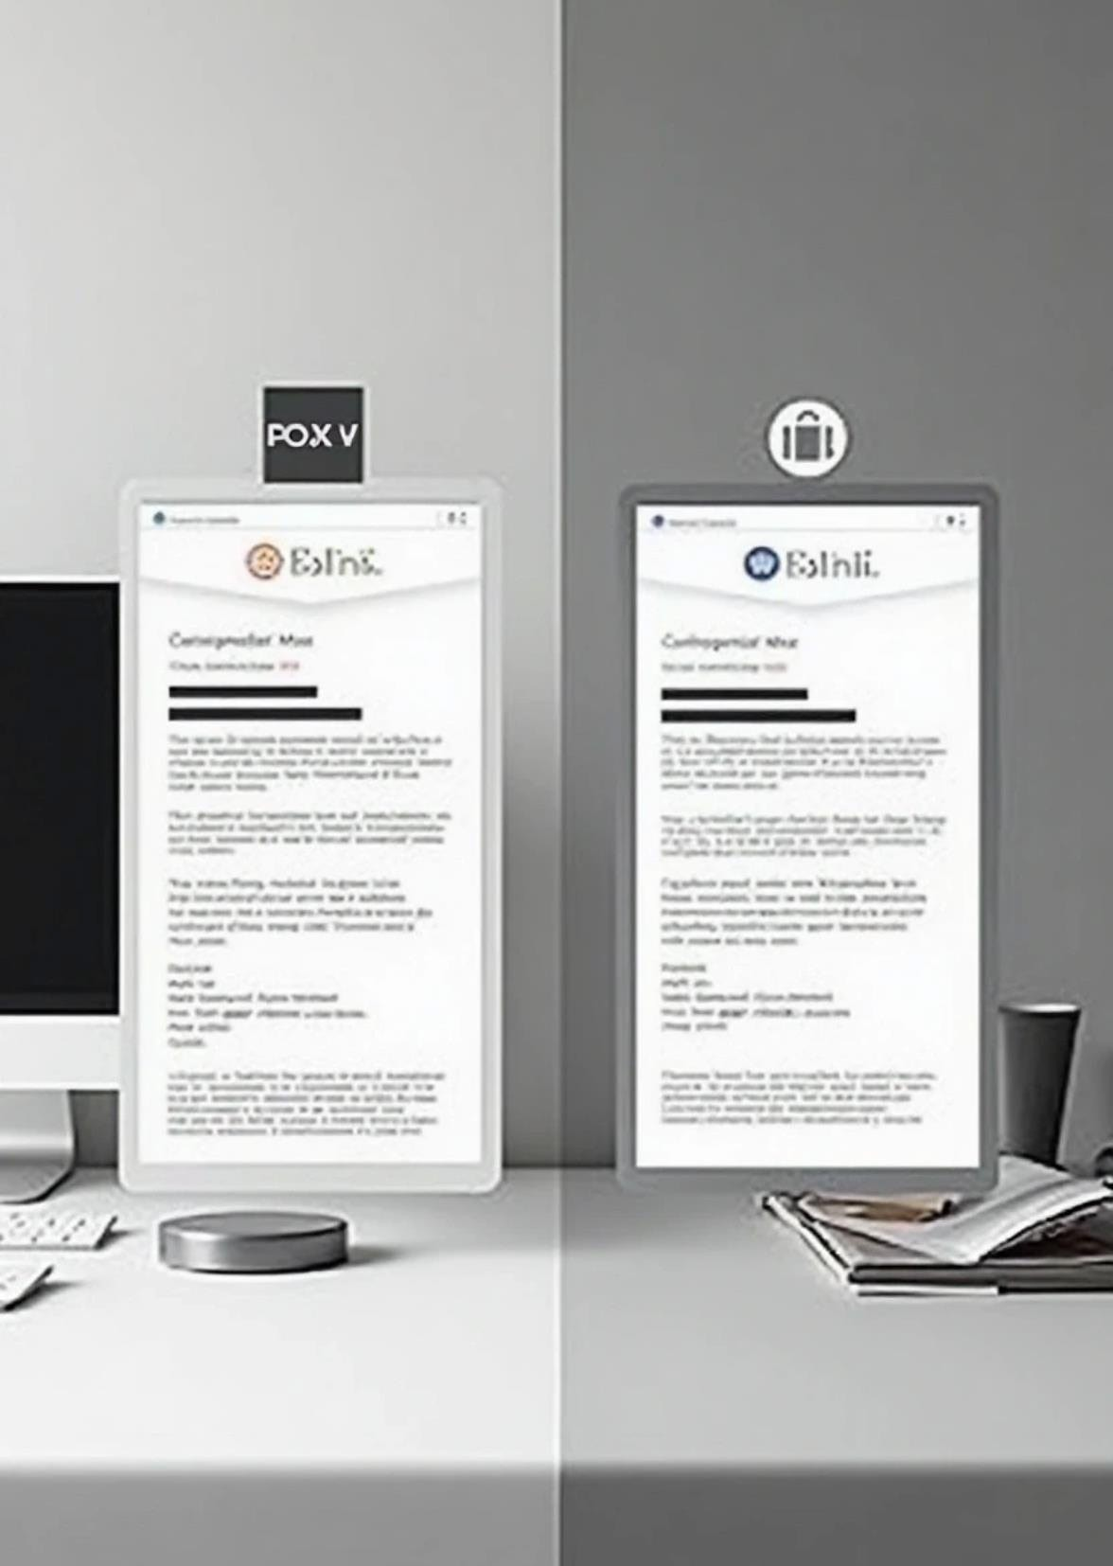







5. Real Example — Fake vs. Real Spot the Difference
1 2
Slide Title
“Spot the Difference”
Content
Show one fake email and one real
company email (side by side)
3
4
Talking Points
Ask participants what differences they notice
Explain why the fake one is dangerous
Visuals
Two email screenshots (sensitive data blurred)

Slide 8




6. How to Protect Yourself Phishing Prevention Tips
Slide Title
“Phishing Prevention Tips”
Content
Don’t click suspicious links or attachments
Verify the sender before replying or clicking
Use strong passwords & MFA
Keep software updated
Enable spam filters
Visuals
Checklist icon
Shield or lock graphic

Slide 9





7. How to Report Suspicious Emails
Reporting Process
1
Slide Title
“Report, Don’t Ignore”
Step-by-step reporting process for your organization
Whom to contact (e.g., IT/security team)
What to includein thereport (screenshot, email headers, etc.) 4
3
Talking Points
Fast reporting prevents wider damage
Visuals
Flow chartshowing “Suspicious Email → Report→ IT Team”
Content

Slide 10





8. Phishing Simulations Why We Run Simulations
Slide Title
“Why We Run Simulations”
Content
To help identify gaps in awareness
To give employees real-life practice
To improve response times
Talking Points
Simulations are not punishment — they’re learning opportunities
Visuals
Simple bar chart or stats from previous simulations (if available)

Slide 11




9. Quick Quiz or Scenario Test Your Knowledge
1 Slide Title
“Test Your Knowledge”
2
Content
Show 1–2 email screenshots
Ask: “Phishing or Legit?”
4 Visuals
Interactive or clickable elements if possible (or ask for hands raised in live training)
3 Talking Points
Engage audience to apply what they’ve learned

Slide 12




10. Summary & Key Takeaways Stay Alert, Stay Secure
Slide Title
“Stay Alert, Stay Secure”
Content
What phishing is
How to spot it
How to report it
Everyone’s role in protecting the organization
Visuals
Recap icons for each key point
Motivational message like “Security starts with you.”

Slide 13







11. Additional Resources & Contacts Need Help?
1
Slide Title
“Need Help?”
2
Content
• IT helpdesk contact
• Security policy link
• Awareness resources (e.g., internal intranet or official cybersecurity sites)
3
Visuals
Support icon or phone/email graphic

Slide 14


12. Thank You & Q&A Thank You
Slide Title
“Thank You”
Content
Open the ﬂoor for questions
Encourage reporting suspicious activities
Visuals
Company logo + thank you message

Slide 15
Thank You

